Slide 1

XYZ corp – smarter loans
London
January 4th 2023
4 Machine learning models to optimize XYZ-Corp lending schemes
Daniel Ebenstein

Slide 2
Agenda
01 | XYZ Corp – lending products overview
02 | Model independent data pre-processing
03 | Early default predictions
04 | Interest rates reviews
05 | Loan purpose prediction
06 | Customer Clustering

Slide 3
XYZ Corp – lending Products overview

Slide 4







XYZ Corp – lending products overview
Exploratory Analysis of the available data
1. The provided Data set can be split into 3 categories of information:
Separation of the above allows to ensure that any ML models built is not predicting variables which are strongly financially entangled together. For example, predicting a loan amount based on the installment amount wouldn’t be valuable.
2. Further the data can be group by data type:
3. Other Observations:
22 fields had a missing value percentage over 50% - mostly niche rating data elements
Relatively large dataset of 820k+ loan history is available which makes it a great candidate for robust ML models
Customer’s Credit information 31 elements
General Customer domain 9 elements
Loan & Fees Details 33 elements
High-cardinality categorical
5 elements
Low-cardinality categorical
6 elements
6 Boolean attributes
56 numerical attributes

Slide 5
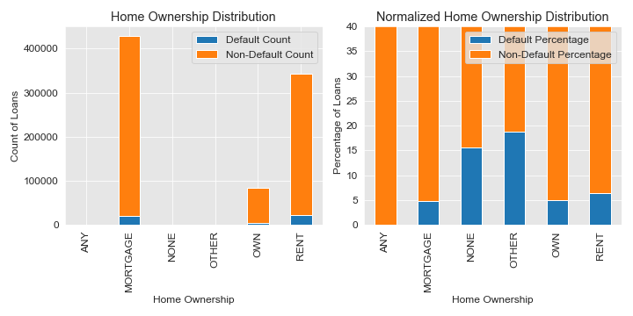
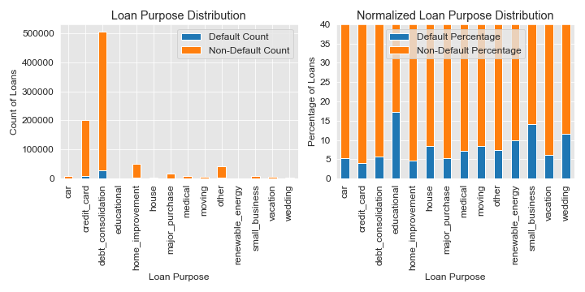
XYZ Corp – lending products overview
Exploratory Analysis of the available data

Slide 6
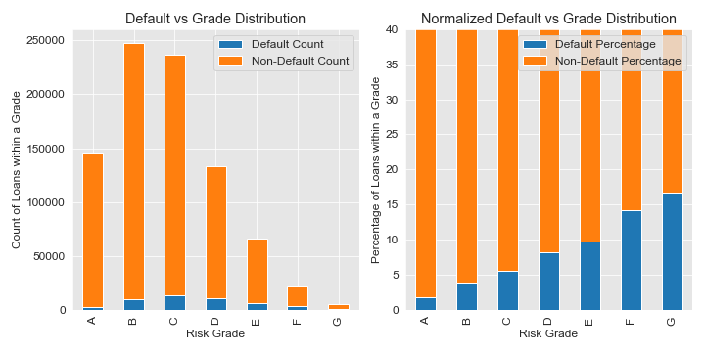
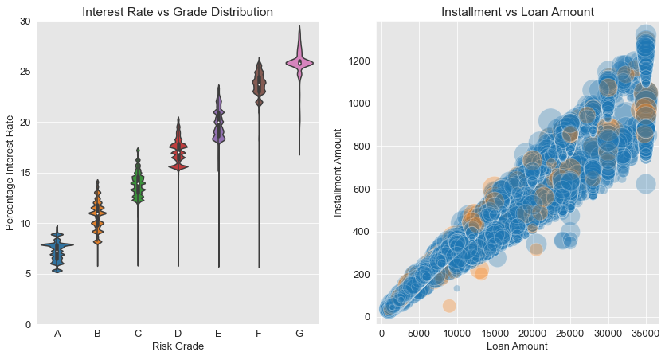
XYZ Corp – lending products overview
Exploratory Analysis of the available data

Slide 7
Model independent data pre-processing

Slide 8
XYZ Corp – Model independent data pre-processing
Pre-processing workflow:
Categorial Data Elements:
Term
Initial_list_status
Application_type
Grade
Home_ownership
Verficication_status
Purpose
Derived Data Elements:
months_since_last_payment – derived based on the file timestamp
months_since_last_credit_pull – derived based on the file timestamp
months_since_earliest_cr_line – derived based on the file timestamp
emp_length – mapped values from strings to integers
late_fees_applied – Boolean indicator if nonzero late fees applied
Numerical Feature Pre-processing:
Total of 25 numerical features were kept
Null values are filled in with median after the split between train and test datasets
5% of outliers are clipped so that the values represent only 95% quantile of the available features
Drop Elements with less then 50% completeness
One hot encode categorical variables
Add derived features
Split into Test and Train datasets (supervised learning only)
Fill nulls, Clip outliers and standardize based on training data
Clean Datasets for training the ML models

Slide 9
Early default predictions

Slide 10
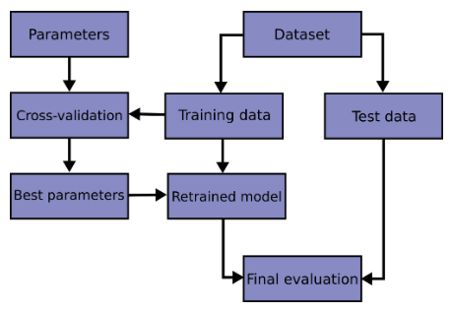
Early default predictions
Identify customer at risk of default early in their loan life-cycle
Model Objective:
Finding probability of loan default based on customer application information, their credit history and loan and product data.
Benefits:
1. The model is expected to determine key features of defaulting loans which can be used to enhance the loan acceptance criteria and reduce amount of defaulted loans in the future.
2. The model is to create default risk flags which will allow relationship managers to review at risk loans before customers start missing payments.
3. Identify potential future work on the existing data to enable more data driven decisions

Slide 11
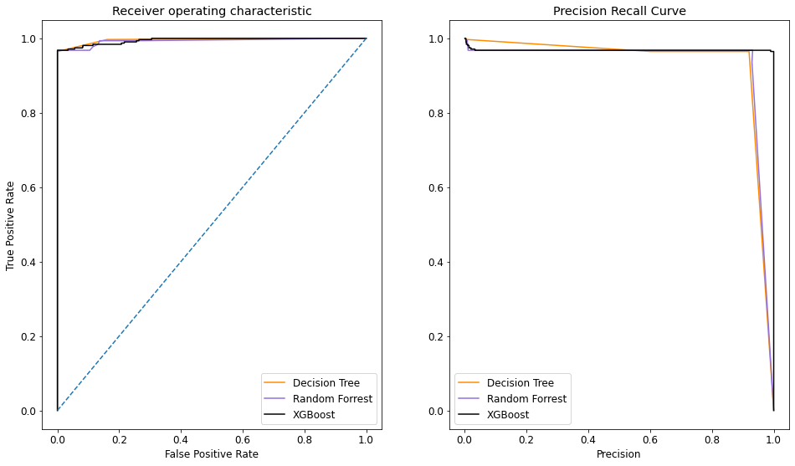
Early default predictions
Identify customer at risk of default early in their loan life-cycle
Models Tested: Decision Tree Classifier, Random Forest Classifier, XGBoost Classifier. All models trained and hyper-tuning with cross-validation technique.
Source code: Credit Default Classification – Model training and tuning
Results: XGBoost model performed best by:
showing the best precision 91.7% versus 88.2-89.0% of the other models
Having marginally higher recall characteristic of 96.8%
Source code: Credit Default Classification – Model Evaluation and Visualization

Slide 12
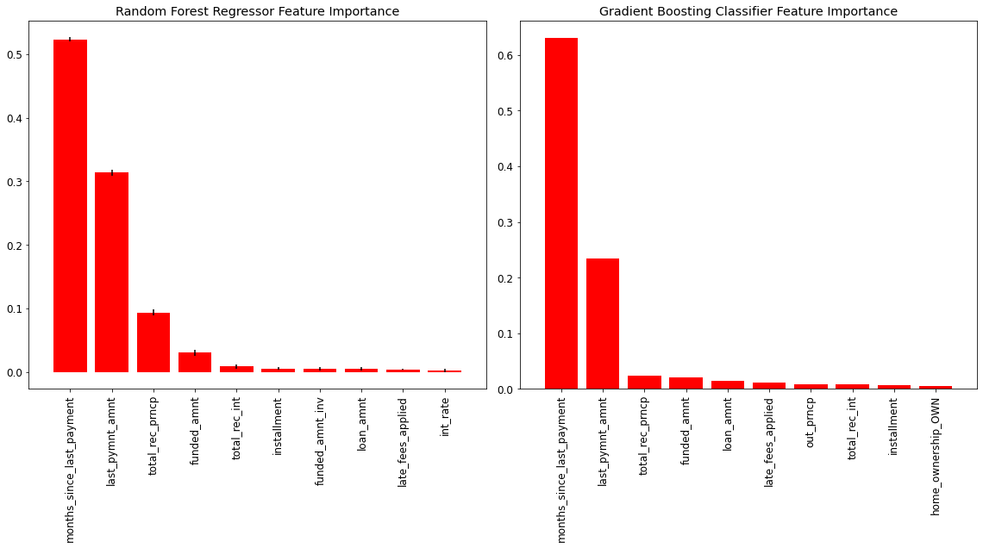
Early default predictions
Identify customer at risk of default early in their loan life-cycle
Models Tested: Decision Tree Classifier, Random Forest Classifier, XGBoost Classifier. All models trained and hyper-tuning with cross-validation technique.
Source code: Credit Default Classification – Model training and tuning
Results: XGBoost model performed best by:
showing the best precision 91.7% versus 88.2-89.0% of the other models
Having marginally higher recall characteristic of 96.8%
Source code: Credit Default Classification – Model Evaluation and Visualization
Interpretation: XYZ Corp current definition of default seems to be 6 months of no payments.
Looking at the ensemble tree-based models, the number of months since last payment and last payment amount make highest contribution in the default predictions.

Slide 13
Early default predictions
Identify customer at risk of default early in their loan life-cycle
Proposed flagging model
Model Probability of Default | Exposure in USD | RM Flag / Notification
< 2% | any | No
2% - 5% | < $10k | Yes – added to watch list
2% - 5% | ≥ $10k | Yes – interest rate review
5% - 10% | < $10k | Yes – added to watch list
5% - 10% | ≥ $10k | Yes – interest rate review
> 10% | any | Yes – interest rate review
Models Tested: Decision Tree Classifier, Random Forest Classifier, XGBoost Classifier. All models trained and hyper-tuning with cross-validation technique.
Source code: Credit Default Classification – Model training and tuning
Results: XGBoost model performed best by:
showing the best precision 91.7% versus 88.2-89.0% of the other models
Having marginally higher recall characteristic of 96.8%
Source code: Credit Default Classification – Model Evaluation and Visualization
Interpretation: XYZ Corp current definition of default seems to be 6 months of no payments.
Looking at the ensemble tree-based models, the number of months since last payment and last payment amount make highest contribution in the default predictions.
Actions:
Create a loan flags and notification system notifications based on the created model to allow early actions on the higher risk loans. This can include general default prevention such as reaching out to the clients to discuss possible arrangements of payments.
Create secondary ML Classification model using customer and application data only, thus allowing to create an enhanced loan acceptance engine.

Slide 14
Interest Rate reviews

Slide 15
Interest Rate Reviews
Handling Special cases of customers at higher risk of defaulting
Model Objective:
The spread of interest rates across all the loans should make them affordable to repay for the clients. This model is trained on non-defaulted loans only and can be used to review interest rate assigned to loans which have now entered a higher risk of defaulting category based on the first model.
Benefits:
1. The model is expected to reduce the number of defaulted loans hence reducing the principal loss due to the credit products.
2. A small number of customers benefiting from this model, will be able to pay off full balances of their loans while creating higher customer satisfaction ratings.
Proposed flagging model
Model Probability of Default | Exposure in USD | RM Flag / Notification
< 2% | any | No
2% - 5% | < $10k | Yes – added to watch list
2% - 5% | ≥ $10k | Yes – interest rate review
5% - 10% | < $10k | Yes – added to watch list
5% - 10% | ≥ $10k | Yes – interest rate review
> 10% | any | Yes – interest rate review

Slide 16
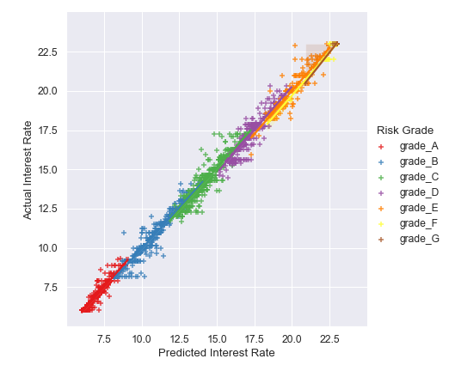
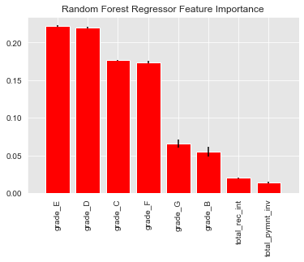
Interest Rate Reviews
Handling Special cases of customers at higher risk of defaulting
Models Tested: Lasso Regression, Random Forest Regression. In Lasso data is scaled using standard scaler. Both models trained and tested using cross-validation. Hyper-tuned with randomized grid search.
Source code: Credit Default Regression – Model training and tuning
Results: Random Forrest Regressor performed significantly better with test data coefficient of determination of 0.98 compared to 0.78 in lasso regression.
Source code: Credit Default Regression – Model Evaluation and Visualization
Interpretation: Random Forest model has shown biggest correlation of the interest rate values with the credit risk ratings of the customers. It has shown that based on the customer credit and loan information, we can consistently and confidently assign them an applicable interest rate.

Slide 17
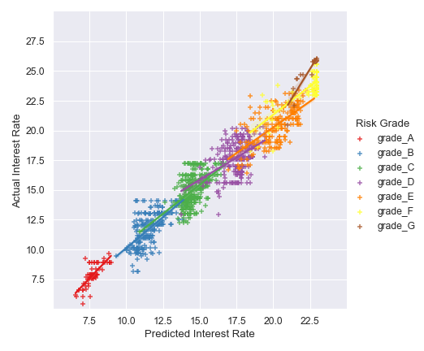
Interest Rate Reviews
Handling Special cases of customers at higher risk of defaulting
Non-defaulted loans test data
Defaulted loans test data
Application: When applying the random forest regression model to calculate suggested interest values, the model shows much lower accuracy on defaulted loans data.
Cross-validation and previously not seen non-defaulted loans data shows the expected behavior of the model.
The same model applied on defaulted loans, shows higher discrepancies between the model predictions and actual interest applied.

Slide 18
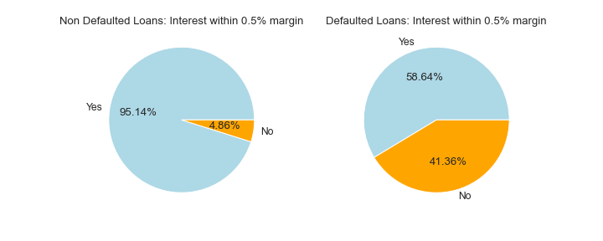
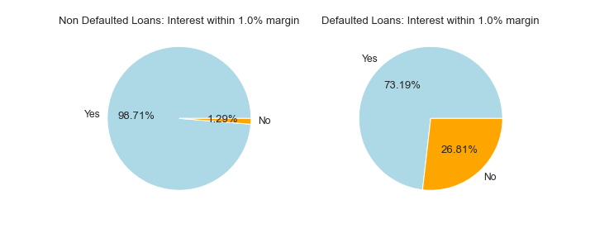
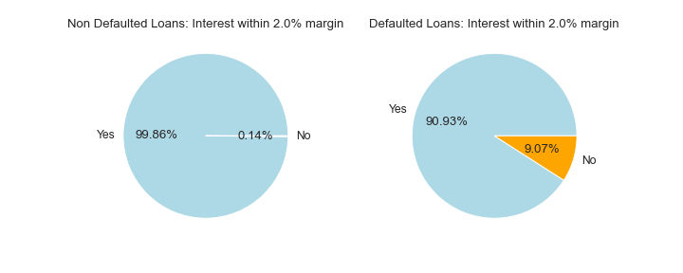
Interest Rate Reviews
Handling Special cases of customers at higher risk of defaulting
Application: When applying the random forest regression model to calculate suggested interest values, the model shows much lower accuracy on defaulted loans data.
Cross-validation and previously not seen non-defaulted loans data shows the expected behavior of the model.
The same model applied on defaulted loans, shows higher discrepancies between the model predictions and actual interest applied.
There are 26.8% of loans which do not fit within 1.0% of the model suggested interest rates.
While 9.1% do no fit within 2.0% of the model suggested interest rates.

Slide 19
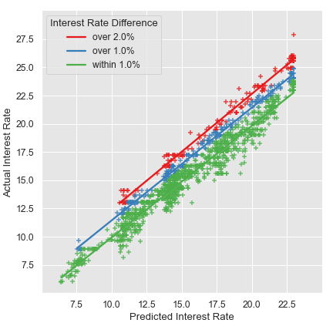
Interest Rate Reviews
Handling Special cases of customers at higher risk of defaulting
Application: When applying the random forest regression model to calculate suggested interest values, the model shows much lower accuracy on defaulted loans data.
Cross-validation and previously not seen non-defaulted loans data shows the expected behavior of the model.
The same model applied on defaulted loans, shows higher discrepancies between the model predictions and actual interest applied.
There are 26.8% of loans which do not fit within 1.0% of the model suggested interest rates.
While 9.1% do no fit within 2.0% of the model suggested interest rates.
Actions:
Loans with interest rates over 2.0% of the model suggest value should be automatically reduced by 1.5%
Loans with interest rates over 1.0% of the model suggest value should be automatically reduced by 1.0%
Other high-default-risk loans should be monitored on a case-by-case basis
Proposed Interest rate review model
Interest rate difference | Action
> 2% | Reduce loan interest rate by 1.5% and monitor the loan risk of default
2% > x > 1% | Reduce loan interest rate by 1.0% and monitor the loan risk of default
< 1% | Mail and personal call to the client to discuss their options to reduce their chances of default

Slide 20
Loan Purpose Prediction

Slide 21
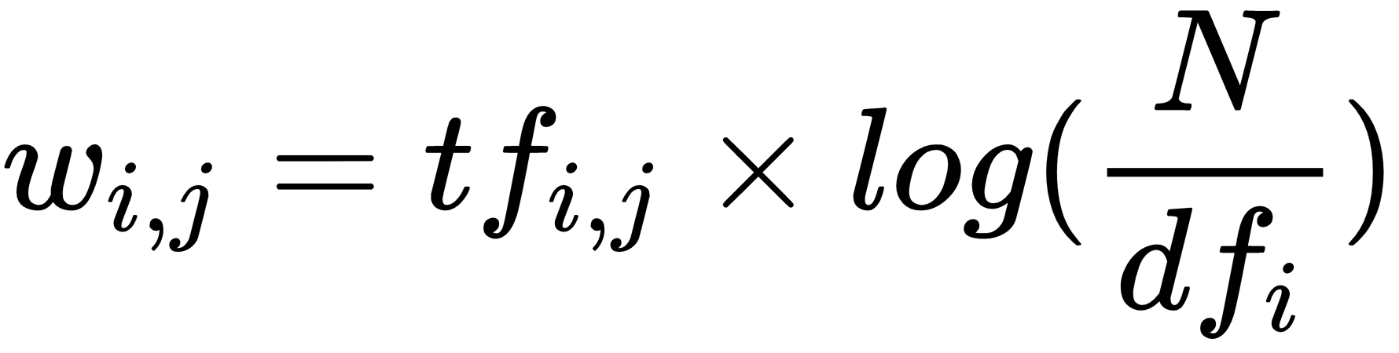
Loan Purpose Prediction
Streamlining the loan approval journey and loan type segmentation
Model Objective:
Predict the loan purpose based on its description. Add additional approval steps for those loans where a differences between the manual and predicted labels is seen and allow better judgement before committing for the loan.
Benefits:
1. Increased validation between manually selected loan purpose and the loan descriptions ensuring better segmentation of Bank’s actual loan portfolio.
2. Potential for better alignment of loan approval journey based on loan purpose label.
Simple Natural Language Processing implementation for multi-class classification
text vectorization using TF-IDF:
Tuning a multi-class classifier on vectorized text data
Class predictions

Slide 22
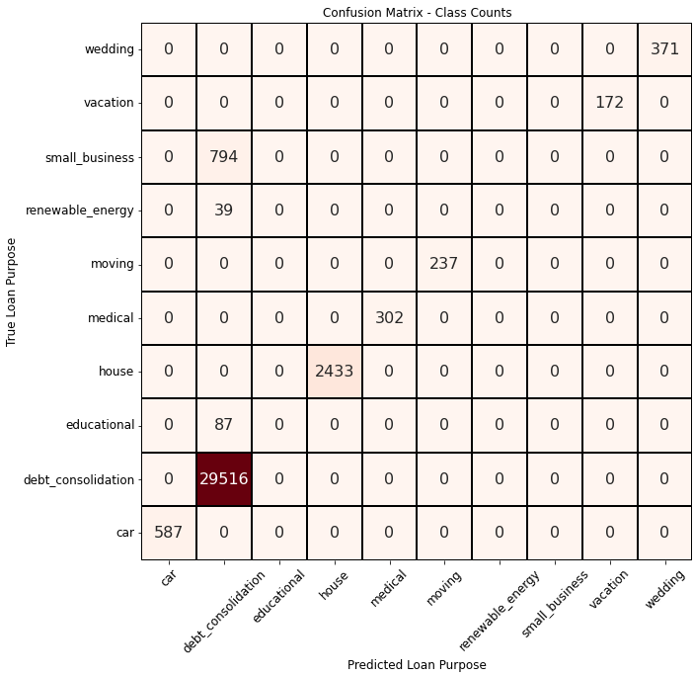
Loan Purpose Prediction
Streamlining the loan approval journey and loan type segmentation
Models Tested: TF-IDF vectorizer for text data. One-Vs-Rest Multi-Class Classification method used with Random Forest Binary Classifier. Limited hyper-tuning was performed due to results showing very little to no variation to changes in hyperparameters.
Source code: Loan Purpose – Model Training
Results: The built model shows 100% accuracy and precision on more than half of loan purpose categories. However, the NLP model is unable to predict any of the small business, renewable energy, and educational loans.
Source code: Loan Purpose – Model Evaluation

Slide 23
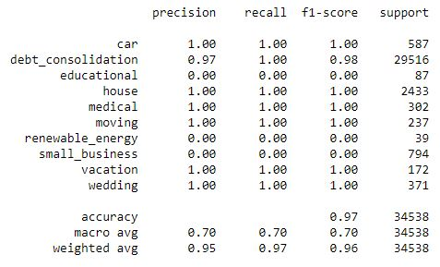
Loan Purpose Prediction
Streamlining the loan approval journey and loan type segmentation
Models Tested: TF-IDF vectorizer for text data. One-Vs-Rest Multi-Class Classification method used with Random Forest Binary Classifier. Limited hyper-tuning was performed due to results showing very little to no variation to changes in hyperparameters.
Source code: Loan Purpose – Model Training
Results: The built model shows 100% accuracy and precision on more than half of loan purpose categories. However, the NLP model is unable to predict any of the small business, renewable energy, and educational loans.
Source code: Loan Purpose – Model Evaluation
Interpretation: 3 unique loan purpose categories had very little training data which might have caused their low confidence.
This combination of larger and small training datasets for some classes most likely caused the incorrect classification of full 3 loan purpose categories.
Actions:
Create more synthetic data to the increase accuracy of the model for minority classes before deploying to production.
When the predicted loan purpose doesn’t align with the customer input – add a manual verification step to ensure the correct classification of the loan before staging for approval.
Future action to implement CI/CD for continued model improvement based on manually corrected labels.

Slide 24
Customer Clustering

Slide 25
Customer Clustering
Categorize customers into target groups
Model Objective:
Group clients based solely on the customer data fields (excluding any loan specific features). The optimum number of customer groups to be obtained based on the outcomes of the unsupervised clustering model.
Benefits:
Create marketing target groups for promoting new products to both, existing and new customers.
Optimize the number of customer categories for both, marketing and potential new product development
Reduce reliance on various 3rd party credit information providers.
Use the developed pre-processing workflow to clean the dataset
Select only customer related features
Evaluate performance of various data scalers and pick the most performant
Perform PCA to reduce data dimensionality
Train and select the most suited clustering model

Slide 26
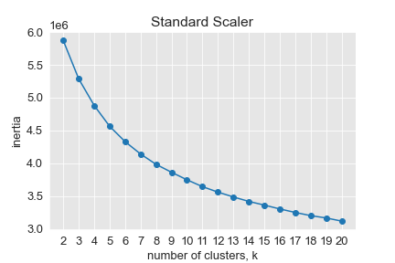
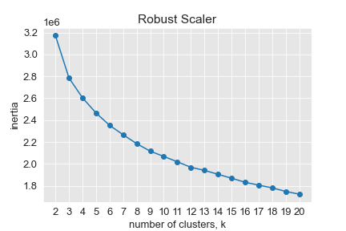
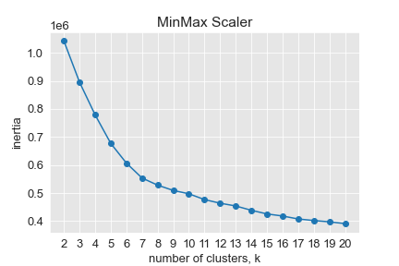
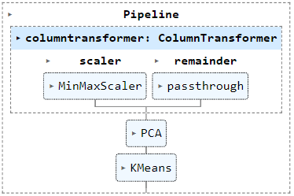
Customer Clustering
Selecting the data scaler
Model and scalers Tested:
An unsupervised model has been chosen since the goal was to group customers without specific leading features.
K-Means model with different cluster numbers has been used to evaluate the performance of different data scalers.
Categorical values were not scaled. They were left as 0 and 1 values only.
Total cluster inertia vs number of clusters has been plotted for 3 tested data scalers – Standard, Robust and MinMax Scalers.
Results and Interpretation:
Features such as employment length, or total income were not the best candidates for standard or robust scaling as they did not follow normal distribution.
MinMax scaler results was the only scaler which shown a small “elbow” indicating that there are clusters present in the dataset.

Slide 27
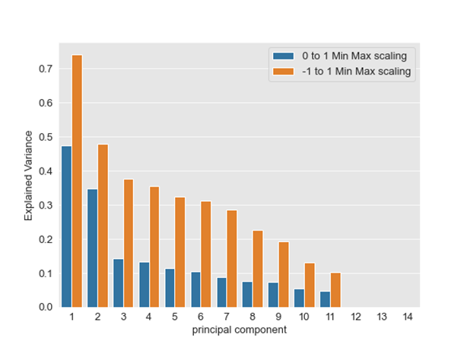
Customer clustering
Principal Component Analysis
Scalers tested using PCA:
Principal Component Analysis was used to reduce the dataset to its principal components and identify the key features with the highest impact in the customer dataset. Moreover, it will allow to create a more definitive clustering model.
2 different MinMax scaling ranges have been tested:
0 to 1 feature scale
-1 to 1 feature scale
Results and Interpretation:
Using the default 0 to 1 scaling aligns all data to the same scale as categorical features use. This reduced the total variance in the dataset more in comparison to -1 to 1 feature scaling. However, 0 to 1 feature scaling resulted in first two principal components to be more dominating, allowing to more confidently use only the first 2 components in the later clustering model.
4 Models are later visualized for testing:
2 and 3 PC components, with 0 to 1 Min Max scaling
2 and 3 PC components, with -1 to 1 Min Max scaling

Slide 28
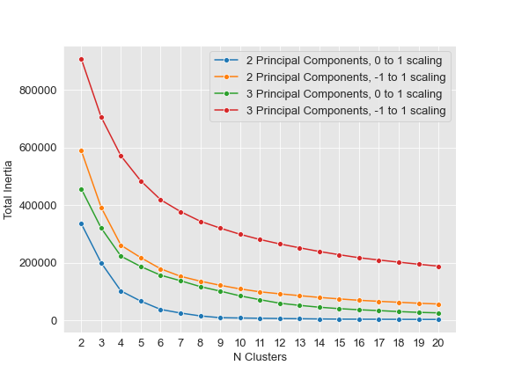
Customer clustering
Clustering models results
Models Tested:
A simple pipeline with MinMax scaler, PCA followed up K-Means clustering has been implemented. The K-Means has been tried for a range of cluster numbers to empirically find the optimal grouping.
Results and Interpretation:
3 out of 4 tested models shown that clusters is the optimal number. Surely reducing number of principal components used allowed for more decisive grouping. Moreover, a reduced feature variance when scaling data from 0 to 1, has also shown a reduced total inertia comparing to -1 to 1 scaling models.

Slide 29
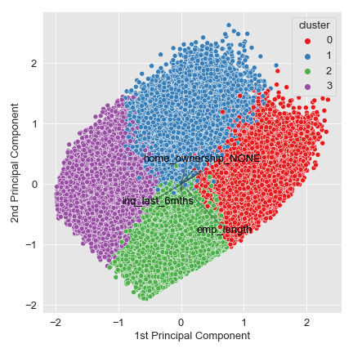
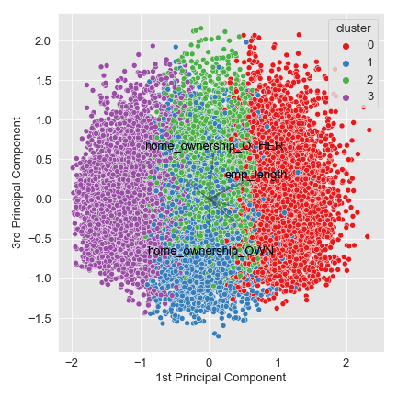
Customer clustering
Clustering models results
Model key Properties:
3 Principal Components
-1 to 1 MinMax Scaling
K-Means with 4 clusters
Standard convergence criteria
Results and Interpretation:
With the selected feature scaling, no apparent clusters are formed.
Dominating features to determine customer category are the employment length and home ownership type, which generally are known to be good indicators of customer’s credit worthiness.

Slide 30
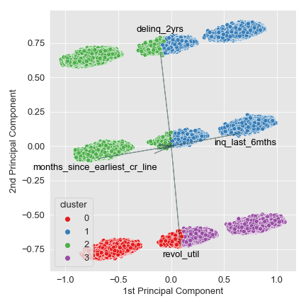
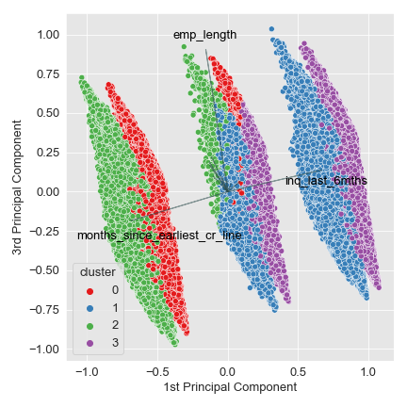
Customer clustering
Clustering models results
Model key Properties:
3 Principal Components
0 to 1 MinMax Scaling
K-Means with 4 clusters
Standard convergence criteria
Results and Interpretation:
With the selected feature scaling, several clear clusters are formed. Lower range scaling gave higher weight to the categorical features
The dominating features highlighted by the PCA are the numerical features such as months since earliest credit line, inquires in the last 6 months and revolving credit utilization.

Slide 31
Thank you

